Slide 1
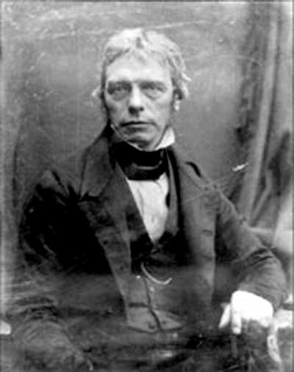
Electromagnetic Induction
This lesson will introduce you to the concepts associated with electromagnetic induction
You will also learn about how Faraday’s law of electromagnetic induction is used to create currents in conductors

Slide 2
Learning Goals
By the end of this lesson, you will be able to:
explain electromagnetic induction
determine the direction of induced current
explain factors that affect the induced current
solve problems involving electromagnetic induction

Slide 3
Success Criteria
Can I:
explain current is induced in a conductor
determine the direction of induced current using Lenz’s law
explain factors that change how much induced current flows in a conductor
solve problems involving electromagnetic induction

Slide 4
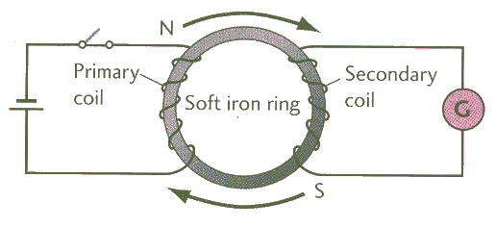
Electromagnetic Induction
In 1831, Michael Faraday discovered the opposite to Oersted’s principle, the law of electromagnetic induction:
A magnetic field that is moving or changing intensity near a conductor causes or induces electrons to flow in the conductor.

Slide 5
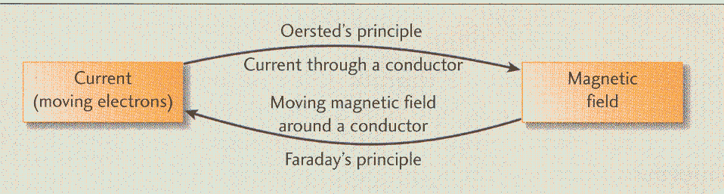
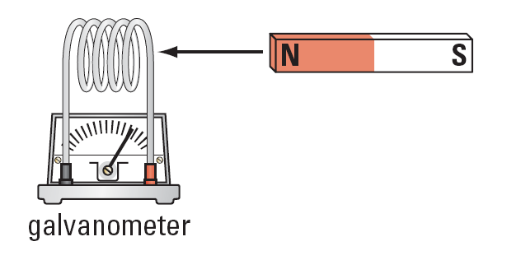

Slide 6
three factors which affect the magnitude of the
induced current:
1. The number of turns on the induction coil.
The strength of the inducing magnet.
The speed or rate of change of the inducing
magnet.

Slide 7
Lenz’s Law
A German physicist, Heinrich Lenz discovered the dir of the induced charge flow. It is known as Lenz’s Law.
Lenz’s Law – The direction of the induced current is in such a way so that the magnetic field it creates opposes the action of the inducing magnetic field.
Lenz reasoned that the magnetic field’s motion was opposed by an induced magnetic field that was being produced by the induced current.

Slide 8

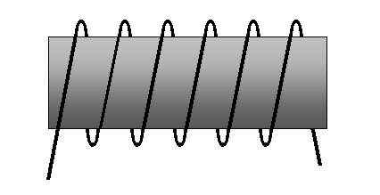
Sample Problem
Determine the direction of the induced current in the coil for the following diagram.
N
S

Slide 9
Sol’n:
Lenz’s Law – in order to oppose an outgoing N pole, a S pole is induced at the end of the coil.
RHR #2 –to get the dir of the current .
N
S
N
S

Slide 10
Sample Problem
Determine the direction of the induced current in the coil for the following diagram.
N
S

Slide 11
Sol’n:
Lenz’s Law – in order to oppose an outgoing N pole, a S pole is induced at the end of the coil.
RHR #2 –to get the dir of the current .
S
N
N
S

Slide 12
Generating Electricity
Faraday’s law of EM induction states that a moving
magnet near a conductor will induce a current in the conductor.
An electric generator is a device which is composed of a permanent magnet and coils of wire. The magnet is made to rotate near the wire.
the motion of the magnet causes an induced current in the wire according to Faraday’s Law.

Slide 13
almost all methods of generating electricity a turbine
is used to spin the magnet.
S
N
the different ways we get the turbine to spin gives us
the different methods of generating electricity.

Slide 14
HOMEWORK
Read Section 13.1 to 13.4
Review Tutorials in the sections
Questions 1 – 2 pg 591
1 – 4 pg 594
1 – 4 pg 604

